Slide 1
엘라스틱서치 적합성 이해하기
Moon Yong Joon

Slide 2
용어 이해 1
Relevance와 Analysis를 명확히 구분이 필요
주어진 쿼리에 얼마나 관련하여 결과를 평가하는 능력
관련성은 TF/ IDF를 사용하여 계산
Relevance
Analysis
별개 정규화 토큰으로 텍스트 블록을 변환하는 과정

Slide 3
용어 이해 2
Query에 대한 구분이 필요
Term based query
term or fuzzy queries 같은 low-level queries 이며 single term을 처리하지만 analysis phase를 가지지 않음
Full text
query
match or query_string queries 같은 high-level queries

Slide 4
실행 절차 : match query 기준
Query에 대한 실행 절차는 4단계로 처리
GET /my_index/my_type/_search
{
"query": {
"match": {
"title": "QUICK!"
}
}
}
Check the field type.
"hits": [
{
"_id": "1",
"_score": 0.5,
"_source": {
"title": "The quick brown fox"
}
},
{
"_id": "3",
"_score": 0.44194174,
"_source": {
"title": "The quick brown fox jumps over the quick dog"
}
},
{
"_id": "2",
"_score": 0.3125,
"_source": {
"title": "The quick brown fox jumps over the lazy dog"
}
}
]
Analyze the query string.
Find matching docs.
Score each doc.

Slide 5
score
Moon Yong Joon

Slide 6
Explain 보는 법

Slide 7
질의 후 explain 명령
하나의 질의를 할 경우 explain을 주고 검색해야 함
GET /_search?explain
{
"query" : { "match" : { "tweet" : "honeymoon" }}
}
Explain을 지정해야 함

Slide 8
Query 질의 결과 보기
하나의 질의를 할 경우 계산하는 법
"_explanation": {
"description": "weight(tweet:honeymoon in 0)
[PerFieldSimilarity], result of:",
"value": 0.076713204,
"details": [
{
"description": "fieldWeight in 0, product of:",
"value": 0.076713204,
"details": [
{
"description": "tf(freq=1.0), with freq of:",
"value": 1,
"details": [
{
"description": "termFreq=1.0",
"value": 1
}
]
},
{
"description": "idf(docFreq=1, maxDocs=1)",
"value": 0.30685282
},
{
"description": "fieldNorm(doc=0)",
"value": 0.25,
}
]
}
]
}
질의에 대한 총 score 값
질의에 대한 세부 score 값
질의에 대한 계산식

Slide 9
Score 계산 산식

Slide 10
Score 계산 산식 1
스코어 계산 산식
score(q,d) =
queryNorm(q)
coord(q,d)
SUM (
tf(t in d),
idf(t)²,
t.getBoost(),
norm(t,d)
) (t in q)

Slide 11
Score 계산 산식 상세
스코어 계산 산식에 대한 상세
score(q,d) | score(q,d) is the relevance score of document d for query q.
 | queryNorm(q) |  | queryNorm(q) is the query normalization factor queryNorm = 1 / sqrt(sumOfSquaredWeights)
 | coord(q,d) |  | coord(q,d) is the coordination factor
 | ∑(t in q) | The sum of the weights for each term t in the query q for document d.
 |  | tf(t in d) | tf(t in d) is the term frequency for term t in document d. tf = sqrt(termFreq)
 |  | idf(t) | idf(t) is the inverse document frequency for term t. idf = 1 + ln(maxDocs/(docFreq + 1))
 |  | t.getBoost() | t.getBoost() is the boost that has been applied to the query
 |  | norm(t,d) | norm(t,d) is the field-length norm, combined with the index-time field-level boost, if any. norm = 1/sqrt(numFieldTerms)

Slide 12
Score 계산 예시

Slide 13
Query 질의에 대한 score
하나의 질의를 할 경우 계산하는 법
curl -XGET 'https://aws-us-east-1-portal10.dblayer.com:10019/top_films/film/172/_explain?pretty=1' -d '
{
"query" : {
"match" : {
"title" : "life"
}
}
}

Slide 14
queryWeight
idf(docFreq=2, maxDocs=50) * queryNorm = queryWeight
{
"description" : "queryWeight, product of:",
"value" : 0.999999940000001,
"details" : [
{
"description" : "idf(docFreq=2, maxDocs=50)",
"value" : 3.8134108
},
{
"value" : 0.26223242,
"description" : "queryNorm"
}
]
},

Slide 15
coordination factor
질의에 대한 조정 계수
The more query terms that appear in the document, the greater the chances that the document is a good match for the query.
Document with fox → score: 1.5
Document with quick fox → score: 3.0
Document with quick brown fox → score: 4.5
Document with fox → score: 1.5 * 1 / 3 = 0.5
Document with quick fox → score: 3.0 * 2 / 3 = 2.0
Document with quick brown fox → score: 4.5 * 3 / 3 = 4.5

Slide 16
coordination factor
조정계수 질의 예시
GET /_search
{
"query": {
"bool": {
"should": [
{ "term": { "text": "quick" }},
{ "term": { "text": "brown" }},
{ "term": { "text": "fox" }}
]
}
}
}

Slide 17
fieldWeight
tf(freq=1.0)* idf(docFreq=2, maxDocs=50)* fieldNorm(doc=38)
{
"description" : "fieldWeight in 38, product of:",
"value" : 1.9067054,
"details" : [
{
"description" : "tf(freq=1.0), with freq of:",
"details" : [
{
"value" : 1,
"description" : "termFreq=1.0"
}
],
"value" : 1
},
{
"value" : 3.8134108,
"description" : "idf(docFreq=2, maxDocs=50)"
},
{
"value" : 0.5,
"description" : "fieldNorm(doc=38)"
}
]
}
],

Slide 18
score
queryWeight * fieldWeight
{
"value" : 1.9067053,
"description" : "score(doc=38,freq=1.0), product of:“
}

Slide 19
하나 필드 Score 처리 예시

Slide 20
Score 계산 산식
스코어 계산 산식에 대한 상세
score(q,d) | score(q,d) is the relevance score of document d for query q.
 | ∑(t in q) | The sum of the weights for each term t in the query q for document d.
 |  | tf(t in d) | tf(t in d) is the term frequency for term t in document d. tf = sqrt(termFreq)
 |  | idf(t) | idf(t) is the inverse document frequency for term t. idf = 1 + ln(maxDocs/(docFreq + 1))
 |  | t.getBoost() | t.getBoost() is the boost that has been applied to the query
 |  | norm(t,d) | norm(t,d) is the field-length norm, combined with the index-time field-level boost, if any. norm = 1/sqrt(numFieldTerms)

Slide 21
Similarity 알고리즘
sqrt(tf) * idf * fln * boost(사용자지정값)를 사용해서 score 값을 계산
TF
Term frequency : 특정 단어(term)이 이 문서에 얼마나 많이 나오는지?
tf = sqrt(termFreq)
IDF
Inverse document frequency : index 내의 모든 문서 내의 필드에 이 단어(term)이 많이 나오는지?
idf = 1 + ln(maxDocs/(docFreq + 1))
FLN
Field-length norm : 이 단어(term)이 있는 필드의 길이? 이 필드가 길면 점수도 낮아진다.
norm = 1/sqrt(numFieldTerms)

Slide 22
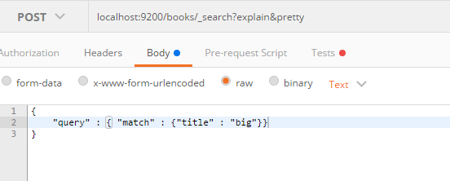
특정 필드 검색 및 설명
실제 필드에 매칭되는 값을 검색하고 score 계산 결과를 확인

Slide 23
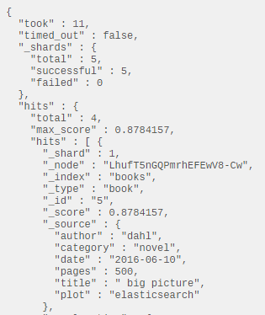
특정 필드 검색결과
big에 매칭되는 결과 조회

Slide 24
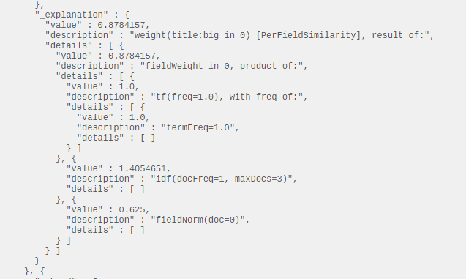
특정 필드 score 설명
TF, IDF, FLN에 대한 값을 표시
TF
IDF
FLN
*
*
0.8784157 = 1.0 * 1.4054651 * 0.625

Slide 25
big/data 두개 가진 필드 score

Slide 26
동일한 질의
big과 data에 대한 term 단위의 질의로 인식
{
"query": {
"match": {
"title": “big data"
}
}
}
{
"query": {
"bool": {
"should": [
{ "term": { "title": "big" }},
{ "term": { "title": "data" }}
]
}
}
}

Slide 27
Score 계산 산식 상세
스코어 계산 산식에 대한 상세
score(q,d) | score(q,d) is the relevance score of document d for query q.
 | queryNorm(q) |  | queryNorm(q) is the query normalization factor queryNorm = 1 / sqrt(sumOfSquaredWeights)
 | coord(q,d) |  | 둘다 해당되므로 무시 됨
 | ∑(t in q) | The sum of the weights for each term t in the query q for document d.
 |  | tf(t in d) | tf(t in d) is the term frequency for term t in document d. tf = sqrt(termFreq)
 |  | idf(t) | idf(t) is the inverse document frequency for term t. idf = 1 + ln(maxDocs/(docFreq + 1))
 |  | t.getBoost() | t.getBoost() is the boost that has been applied to the query
 |  | norm(t,d) | norm(t,d) is the field-length norm, combined with the index-time field-level boost, if any. norm = 1/sqrt(numFieldTerms)

Slide 28
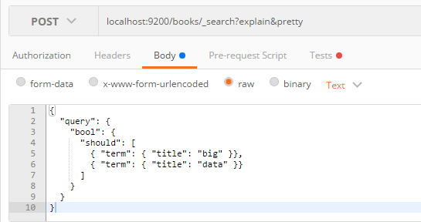
특정 필드 검색 (big,data)
big data를 다 가진 경우는 coordination factor가 존재하지 않음

Slide 29
Title :Big data score
big data score = big score + data score
0.883883 = 0.44194174+ 0.44194174
max_score" : 0.8838835,
"hits" : [ {
"_shard" : 3,
"_node" : "LhufT5nGQPmrhEFEwV8-Cw",
"_index" : "books",
"_type" : "itbook",
"_id" : "1",
"_score" : 0.8838835,
"_source" : {
"title" : "big data",
"author" : [ "hwang", "kang" ],
"price" : 30000,
"pages" : 300
},
"_explanation" : {
"value" : 0.8838835,
"description" : "sum of:"

Slide 30
big : fieldWeight
fieldWeight = tf * idf * fieldnorm
{
"value" : 0.625,
"description" : "fieldWeight in 0, product of:",
"details" : [ {
"value" : 1.0,
"description" : "tf(freq=1.0), with freq of:",
"details" : [ {
"value" : 1.0,
"description" : "termFreq=1.0",
"details" : [ ]
} ]
}, {
"value" : 1.0,
"description" : "idf(docFreq=1, maxDocs=2)",
"details" : [ ]
}, {
"value" : 0.625,
"description" : "fieldNorm(doc=0)",
"details" : [ ]
}
}

Slide 31
big : queryWeight
queryWeight = idf(docFreq=1, maxDocs=2)“ * queryNorm
{
"value" : 0.70710677,
"description" : "queryWeight, product of:",
"details" : [ {
"value" : 1.0,
"description" : "idf(docFreq=1, maxDocs=2)",
"details" : [ ]
}, {
"value" : 0.70710677,
"description" : "queryNorm",
"details" : [ ]
}
}

Slide 32
big : score
big score = queryWeight * fieldWeight
0.44194174 = 0.70710677 * 0.625
"value" : 0.44194174,
"description" : "weight(title:big in 0) [PerFieldSimilarity], result of:",
"details" : [ {
"value" : 0.44194174,
"description" : "score(doc=0,freq=1.0), product of:",

Slide 33
data : fieldWeight
fieldWeight = tf * idf * fieldnorm
{
"value" : 0.625,
"description" : "fieldWeight in 0, product of:",
"details" : [ {
"value" : 1.0,
"description" : "tf(freq=1.0), with freq of:",
"details" : [ {
"value" : 1.0,
"description" : "termFreq=1.0",
"details" : [ ]
} ]
}, {
"value" : 1.0,
"description" : "idf(docFreq=1, maxDocs=2)",
"details" : [ ]
}, {
"value" : 0.625,
"description" : "fieldNorm(doc=0)",
"details" : [ ]
}

Slide 34
data : queryWeight
queryWeight = idf(docFreq=1, maxDocs=2)“ * queryNorm
{
"value" : 0.70710677,
"description" : "queryWeight, product of:",
"details" : [ {
"value" : 1.0,
"description" : "idf(docFreq=1, maxDocs=2)",
"details" : [ ]
}, {
"value" : 0.70710677,
"description" : "queryNorm",
"details" : [ ]
}
}

Slide 35
data : score
big score = queryWeight * fieldWeight
0.44194174 = 0.70710677 * 0.625
"value" : 0.44194174,
"description" : "weight(title:data in 0) [PerFieldSimilarity], result of:",
"details" : [ {
"value" : 0.44194174,
"description" : "score(doc=0,freq=1.0), product of:"

Slide 36
big 값만 가진 필드 계산

Slide 37
Score 계산 산식 상세
스코어 계산 산식에 대한 상세
score(q,d) | score(q,d) is the relevance score of document d for query q.
 | queryNorm(q) |  | queryNorm(q) is the query normalization factor queryNorm = 1 / sqrt(sumOfSquaredWeights)
 | coord(q,d) |  | coord(q,d) is the coordination factor
 | ∑(t in q) | The sum of the weights for each term t in the query q for document d.
 |  | tf(t in d) | tf(t in d) is the term frequency for term t in document d. tf = sqrt(termFreq)
 |  | idf(t) | idf(t) is the inverse document frequency for term t. idf = 1 + ln(maxDocs/(docFreq + 1))
 |  | t.getBoost() | t.getBoost() is the boost that has been applied to the query
 |  | norm(t,d) | norm(t,d) is the field-length norm, combined with the index-time field-level boost, if any. norm = 1/sqrt(numFieldTerms)

Slide 38
Title :big picture score
big data score = big score + data score
0.883883 = 0.44194174+ 0.44194174
max_score" : 0.8838835,
"hits" : [ {
"_shard" : 3,
"_node" : "LhufT5nGQPmrhEFEwV8-Cw",
"_index" : "books",
"_type" : "itbook",
"_id" : "1",
"_score" : 0.8838835,
"_source" : {
"title" : "big data",
"author" : [ "hwang", "kang" ],
"price" : 30000,
"pages" : 300
},
"_explanation" : {
"value" : 0.8838835,
"description" : "sum of:"

Slide 39
big : fieldWeight
fieldWeight = tf * idf * fieldnorm
{
"value" : 0.8784157,
"description" : "fieldWeight in 0, product of:",
"details" : [ {
"value" : 1.0,
"description" : "tf(freq=1.0), with freq of:",
"details" : [ {
"value" : 1.0,
"description" : "termFreq=1.0",
"details" : [ ]
} ]
}, {
"value" : 1.4054651,
"description" : "idf(docFreq=1, maxDocs=3)",
"details" : [ ]
}, {
"value" : 0.625,
"description" : "fieldNorm(doc=0)",
"details" : [ ]
}
}

Slide 40
big : queryWeight
queryWeight = idf(docFreq=1, maxDocs=2)“ * queryNorm
{
{
"value" : 0.5564505,
"description" : "queryWeight, product of:",
"details" : [ {
"value" : 1.4054651,
"description" : "idf(docFreq=1, maxDocs=3)",
"details" : [ ]
}, {
"value" : 0.3959191,
"description" : "queryNorm",
"details" : [ ]
} ]
}

Slide 41
big : score
big score = queryWeight * fieldWeight
0.48879483 = 0.5564505 * 0.8784157
details" : [ {
"value" : 0.48879483,
"description" : "sum of:",
"details" : [ {
"value" : 0.48879483,
"description" : "weight(title:big in 0) [PerFieldSimilarity], result of:",
"details" : [ {
"value" : 0.48879483,
"description" : "score(doc=0,freq=1.0), product of:",

Slide 42
big : coord
coord(1/2)
{
"value" : 0.5,
"description" : "coord(1/2)",
"details" : [ ]
}

Slide 43
big picture: score
big score = big score * coord
0.24439742 = 0.48879483 * 0.5
"value" : 0.24439742,
"description" : "product of:"

Slide 44
쿼리가중치 (boost)
Moon Yong Joon

Slide 45
query time

Slide 46
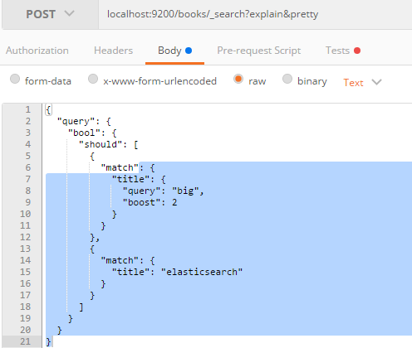
쿼리 검색 설명
Title 필드로 2가지 조건을 검색할 경우
Boost 계산이 2개이상이 있을 경우 계산됨

Slide 47
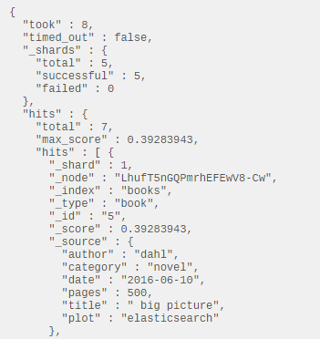
Query 검색결과
big에 매칭되는 결과 조회
검색결과값 = 쿼리가중치 * 필드가중치
0.78567886 = 0.8944272 * 0.8784157
최종값 = 검색결과값/(1/쿼리갯수)
0.39283943 = 0.78567886*0.5

Slide 48
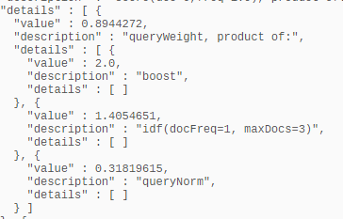
쿼리 weight 설명
TF, IDF, FLN에 대한 값을 표시
boost
IDF
Query
Norm
*
*
0.8944272 = 2.0 * 1.4054651 * 0.31819615

Slide 49
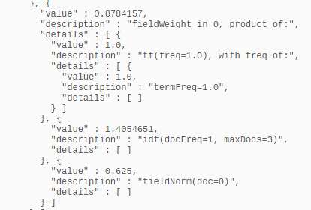

필드 weight 설명
TF, IDF, FLN에 대한 값을 표시
TF
IDF
FLN
*
*
0.8784157 = 1.0 * 1.4054651 * 0.625

